Slide 1
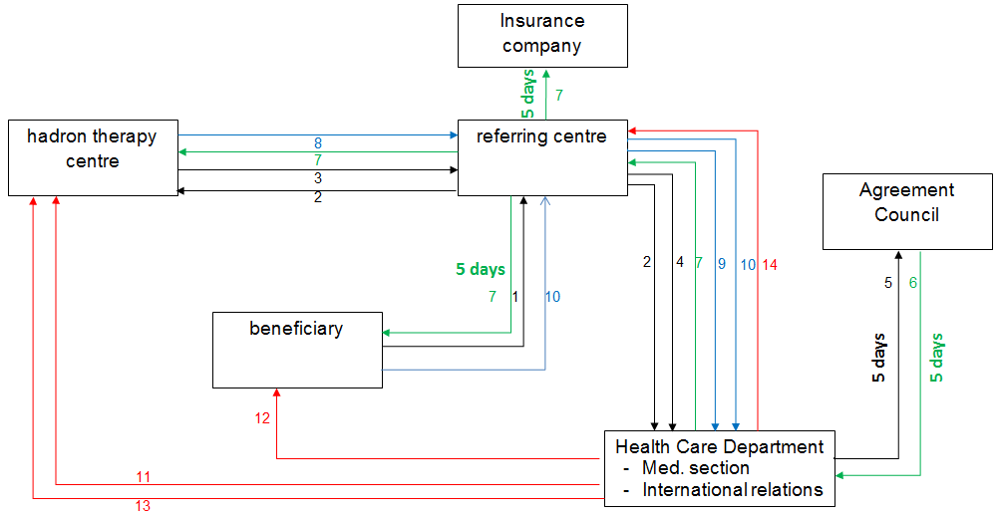

Slide 2
Procedure
In the report of the multidisciplinary oncology consultation, hadron therapy is suggested to the patient. His or her physician contacts one of the radiotherapy centres that has an agreement to refer patients for hadron therapy (« referring centre »).
A multidisciplinary report is also required in case of non-cancerous CNS tumor.
The referring centre sends a request to the Health Care Department of the NIHDI (to Hadrontherapie@inami.fgov.be) to open a file and, at the same time, sends a request to treat the patient to a specialized centre for hadron therapy. The Health Care Department attributes a file number while waiting for a duly completed application.
The hadron therapy centre informs the referring centre of its consent to treat the patient (or its refusal). In case of a negative answer, the referring centre contacts another hadron therapy centre.
The referring centre sends the completed application file to the Health Care Department (by registered post) as well as the consent to treat from the hadron therapy centre, together with the treatment cost estimate.
The Health Care Department sends this completed application file to the members of the Agreement Council (through a « secure website ») within 5 working days after receiving it .

Slide 3
Decision Agreement Council (1)
6. Within 5 working days after receiving the application file, the members of the Agreement Council send their advice to the Health Care Department.
This decision can be:
  a positive decision in case of a positive unanimous advice (at least 2 advices per « bench »)
  a request for additional information, after which the procedure starts over by mail
  in case of a negative advice (to be motivated) without consensus, the decision is postponed to the next scheduled meeting after inviting the members of the Agreement Council in person (meeting scheduled twice a month). In case of a persisting disagreement, the chairperson will decide.
7. The Health Care Department sends the final decision within 5 working days to the referring centre that will send it to the hadron therapy centre together with a payment guarantee. The referring centre send also the decision to the beneficiary and, in case of positive advice, to the beneficiary’s insurance company.
In case of a positive decision by the Agreement Council, the cost for treatment, the transportation costs (possibly) and accommodation expenses for the beneficiary and (possibly) the person accompanying him or her, are covered.
The NIHDI gives a payment warranty (possibility of a down payment).

Slide 4
Decision Agreement Council (2)
At least 2 members on each bench must send an advice for the Agreement Council to make a valid decision. The representatives of the NIHDI do not cast a vote.
Any negative advice must be motivated.
  Any non-unanimous negative advice triggers a second tour of requests. In case no consensus was reached by mail, the case will be discussed at the first scheduled plenary meeting; in case of a persisting disagreement, the chairperson (NIHDI) will decide.
  There are no appeal proceedings before the Agreement Council.

Slide 5
Bills
Bill for a consent to treat and for the treatment costs in the hadron therapy centre
Bills sent by the hadron therapy centre (see 8.) and bill for the lump sum to which the radiotherapy referring centre is entitled to for their coordination efforts
Bills of transportation costs ( possibly) and accommodation expenses for the patient and the person accompanying him or her(possibly), sent to the NIHDI through the radiotherapy referring centre

Slide 6
Payments
Payment of treatment costs* to the hadron therapy centre in charge of the treatment
(* while taking into account the amount possibly paid in advance)
Intervention in the transportation costs and accommodation expenses for the patient (and possibly the person accompanying him or her)
Payment to the treating hadron therapy centre for their advice
Payment to the radiotherapy referring centre for their coordination efforts

Slide 7
Transportation costs and accommodation expenses
Accommodation expenses: an accommodation allowance up to € 40.00 per day per person.
These costs are reimbursed for the patient and the person accompanying him or her for the entire treatment period when it involves a child (younger than 15) or an adult in medical need.
Travel allowance when going abroad: from a distance of 350 km in a straight line from Brussels, costs are reimbursed at € 0.25 per km (by car). A trip by train or by plane is entirely reimbursed (price ‘second class’).

